Slide 1
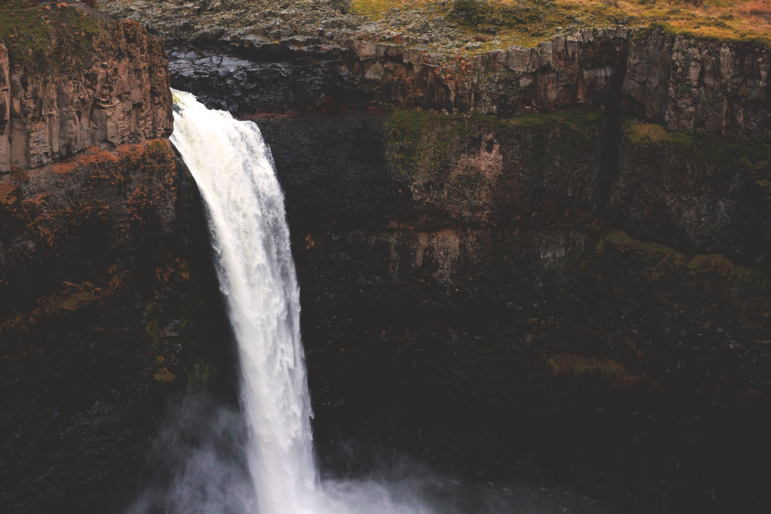
Nanofiltration
Notes:
Resource: https://unsplash.com/photos/kDj82KFbRvU/download

Slide 2
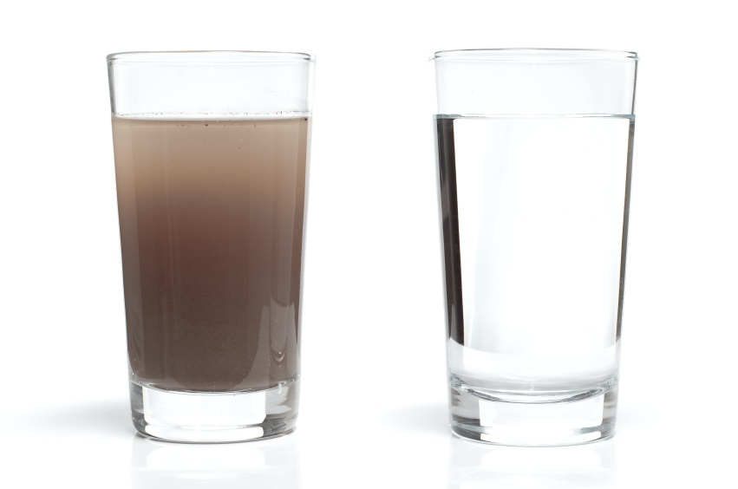
Water
Which one would YOU drink?
  *Answer on your worksheet
Notes:
Resource: http://diyprepping.com/tag/clean-water/

Slide 3
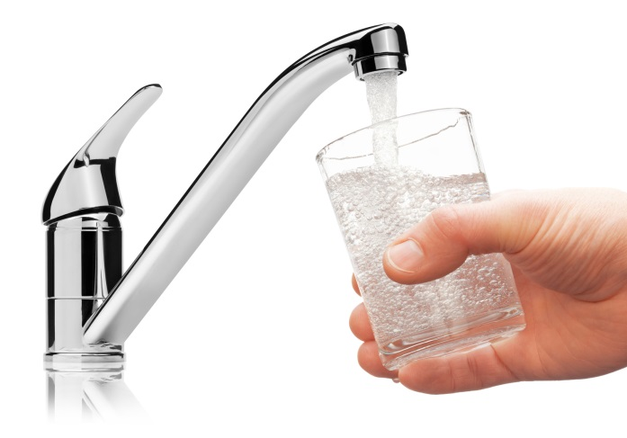
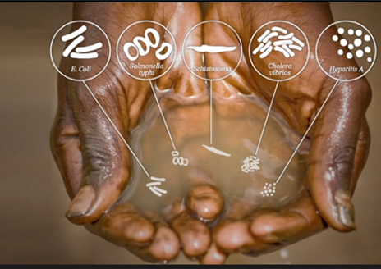
Isn’t all drinking water clean?
Do you think tap water goes through a filtration process?*
What would happen if water wasn’t filtered?*
Are there places in the world where drinking water is not filtered?*
Notes:
Resources: http://www.cdc.gov/healthywater/drinking/public/water_treatment.html
http://www.distilledwaterassociation.org/bottled-water-vs-tap-water-drink-it-with-or-without-poop/
http://dirtywaterintheworld.weebly.com/illness-and-disease.html

Slide 4
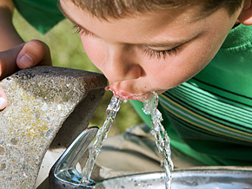
Tap Water in the U.S.
Drinking water in the United States is among the safest in the world!
Our water goes through a very specific filtration process
  Things are even added to make the water taste better!
Notes:
Resource: http://coloradobip.sgm-inc.com/

Slide 5
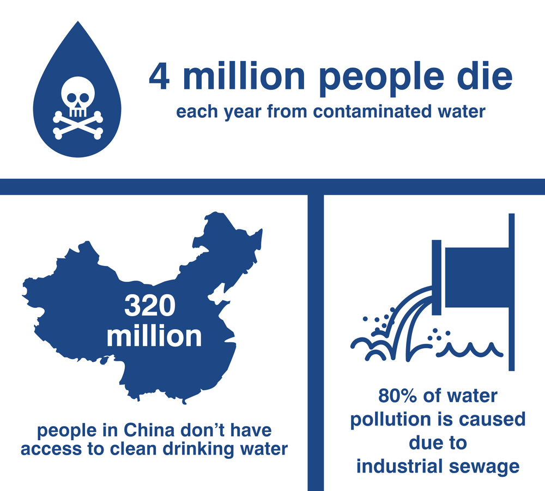
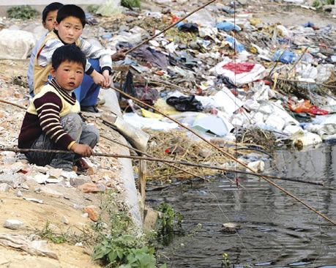
Meanwhile in China
In China 60% of their water is undrinkable.
Even their tap water is undrinkable!
Why is the water so dirty?*
  Pollution
Notes:
Resources: http://www.naturalnews.com/045089_industrial_pollution_China_drinking_water.html#
http://www.chinatravel.com/facts/drinking-water.htm
http://en.mercopress.com/2009/12/04/china-attacks-water-pollution-and-plans-massive-investments
http://www.100smarterlivingideas.com/drinkable-book/

Slide 6
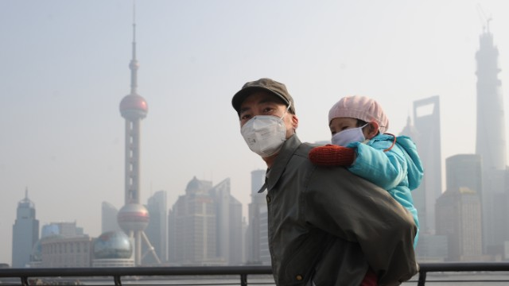
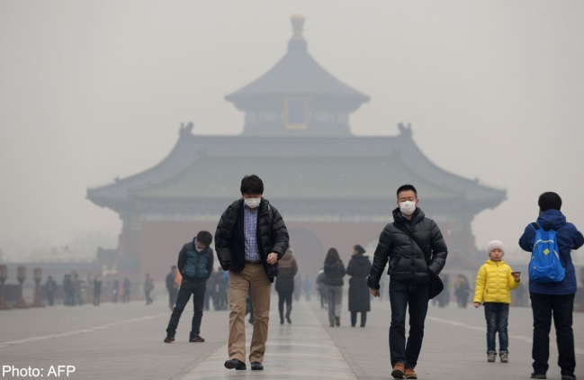
Meanwhile in China…
Due to high levels of urban development, the air in China is highly polluted.
  So, when it rains the rain is impure and goes into the ground
Agriculture is important to their country, but what do plants need to grow?*
  Clean water
  If the water is polluted, do you think the plants are okay to eat?*
Why is this a problem? And can it affect you?
Notes:
http://news.asiaone.com/news/business/chinas-smog-driving-top-foreign-talent-away-us-business-survey
http://www.cnn.com/2014/01/06/opinion/china-pollution-opinion-taoxie/index.html

Slide 7
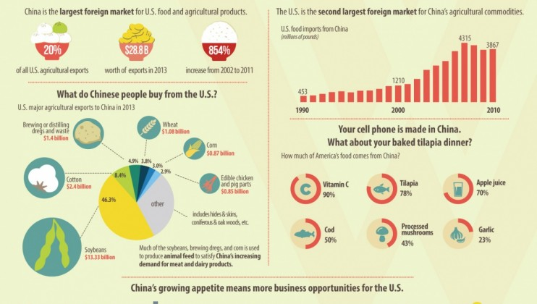
America and China
United States imported roughly 3.9 billion pounds of agricultural products from China in 2010
  How does that affect you?*
Notes:
Resource: http://www.americanmanufacturing.org/blog/entry/the-u.s.-imports-a-lot-of-food-from-china-and-you-might-be-surprised-whats

Slide 8
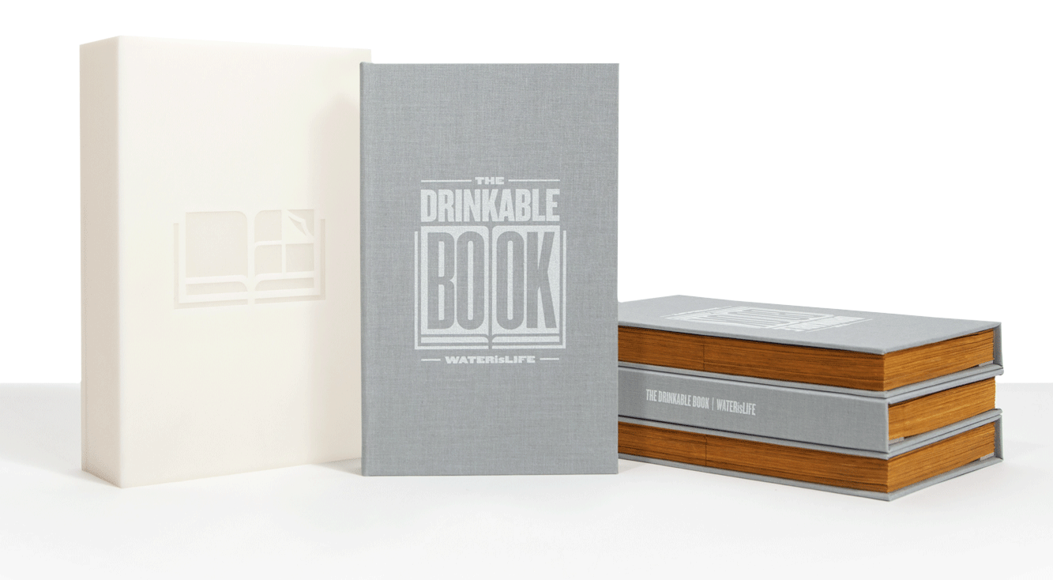
Is anything being done?
http://waterislife.com/
https://drinkablebook.tilt.com/the-drinkable-book
What do you think about the drinkable book?*
Notes:
Resources: http://waterislife.com/clean-water/new-technology
https://drinkablebook.tilt.com/the-drinkable-book

Slide 9
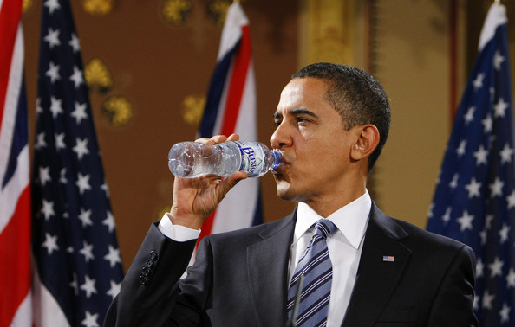
Problem solving!
Now it’s your turn! Get in groups of 4 and…
  Come up with a scenario where suddenly America’s water became polluted.
  The president comes to YOU and says “Help! All of our water is polluted. We need your help to get it clean again because people are getting sick. What should I do?”
    What do you tell him to do?*
  Have fun with it!
Notes:
Resource: http://www.zimbio.com/pictures/tR_OFqNkpP7/Gordon+Brown+President+Obama+Hold+Talks+Foreign/1ZKzlHBd7Jc/Barack+Obama

Slide 10

Did you know?
Did you know that we can use REALLY small things called nano-particles to help us clean water?
WHAT IS NANO?
Notes:
Resource: http://www.nanotechproject.org/topics/nano101/

Slide 11
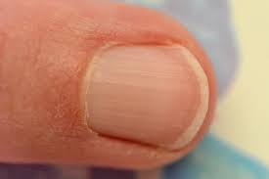
First, what is nano?
Nano is a size, and it’s really small! It comes from the Greek word meaning “dwarf” and means one-billionth (1/1,000,000,000)​
A nanometer is one-billionth of a meter​
Your fingernail grows 1 nm per second​
Notes:
Resource: https://commons.wikimedia.org/wiki/File:Ongle_du_doigt_de_la_main_-_Fingernail_hand.jpg

Slide 12
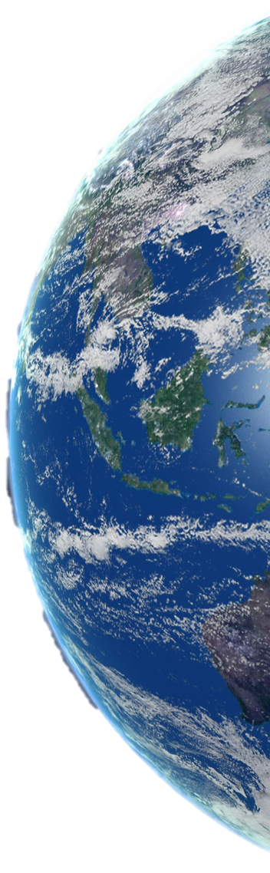
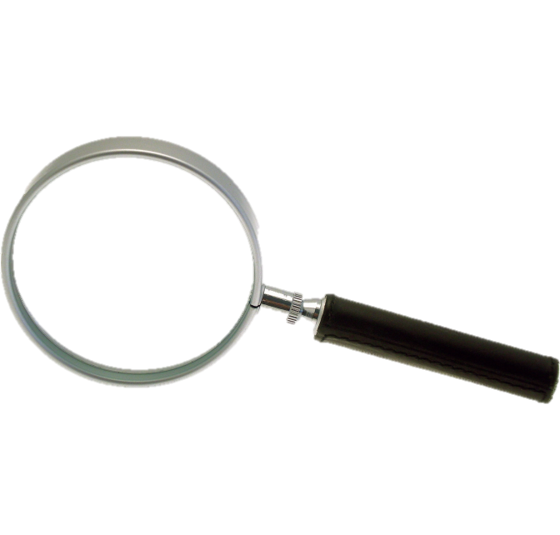
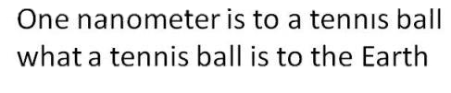
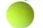
What is nano?
Notes:
Teacher Notes:
The students need to understand what nano is because... This is where you explain to your students what nano is and what it means in science.
First, what is nano?
Nano is a size, and it’s really small! It comes from the Greek word meaning “dwarf” and means one-billionth (1/1,000,000,000)​
A nanometer is one-billionth of a meter​
Your fingernail grows 1 nm per second​
Resources: http://www.solstation.com/stars/earth.htm
http://www.clipartbest.com/tennis-ball-picture
http://www.clipartpanda.com/categories/magnifying-glass-clipart-transparent-background

Slide 13
But really, how small is nano?
Nanoscale refers to measurements between 1 and 100 nanometers.
http://learn.genetics.utah.edu/content/cells/scale/
Notes:
Teacher Notes:
Nanoscale refers to measurements between 1 and 100 nanometers.
Resource: http://learn.genetics.utah.edu/content/cells/scale/
We suggest keeping the interactive nanoscale graphic open in another window and referring to it in slide 25

Slide 14
Engage Questions
How many of you have a water filter at home?
Do any of your parents drink coffee?
Have you ever seen what is left in a coffee filter after it is brewed?

Slide 15
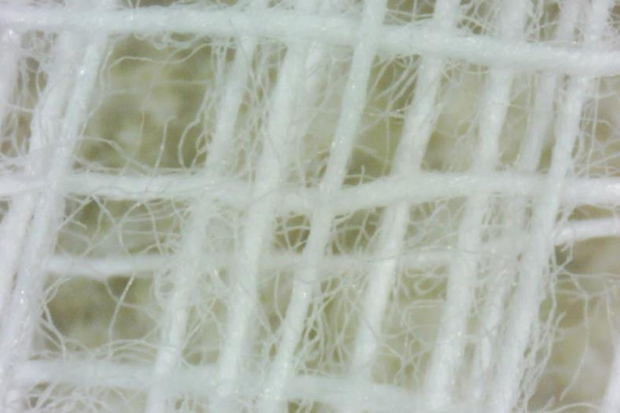
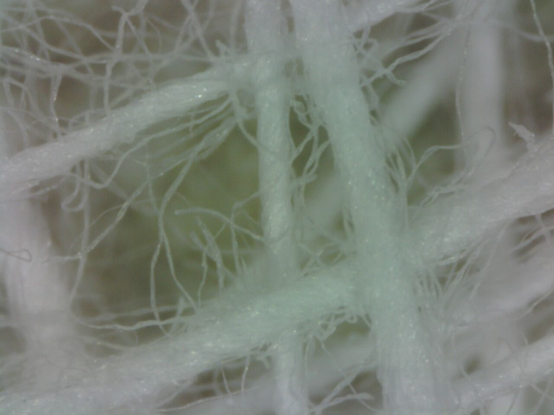
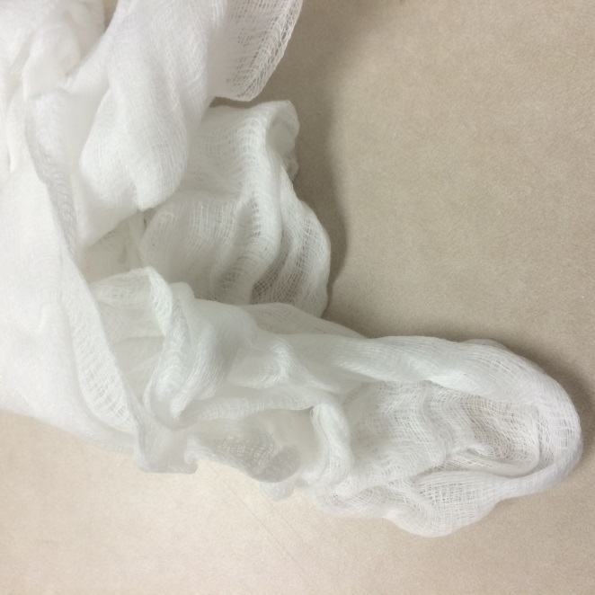
100X image of a cheesecloth
1 mm
1 cm
200X image of a cheesecloth
1 mm
Cheesecloth

Slide 16
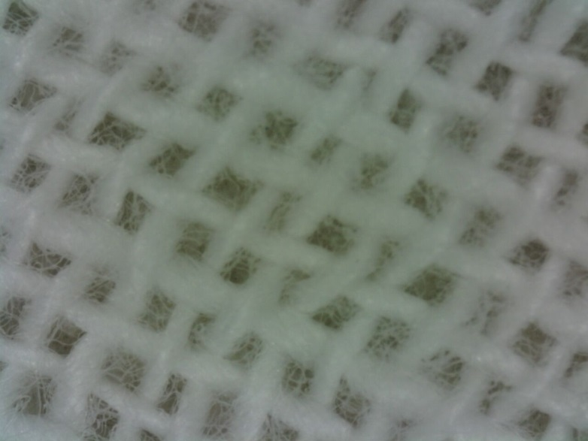
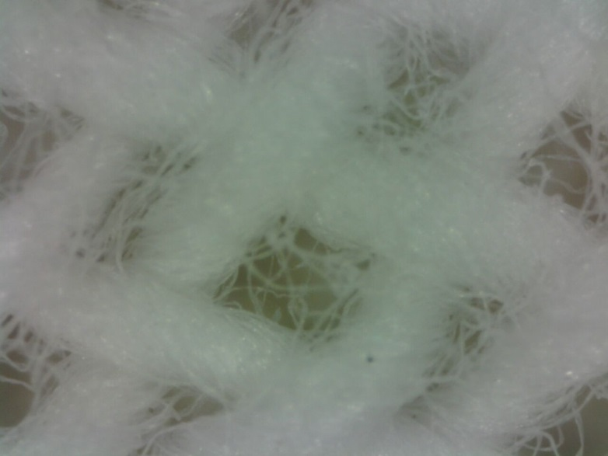
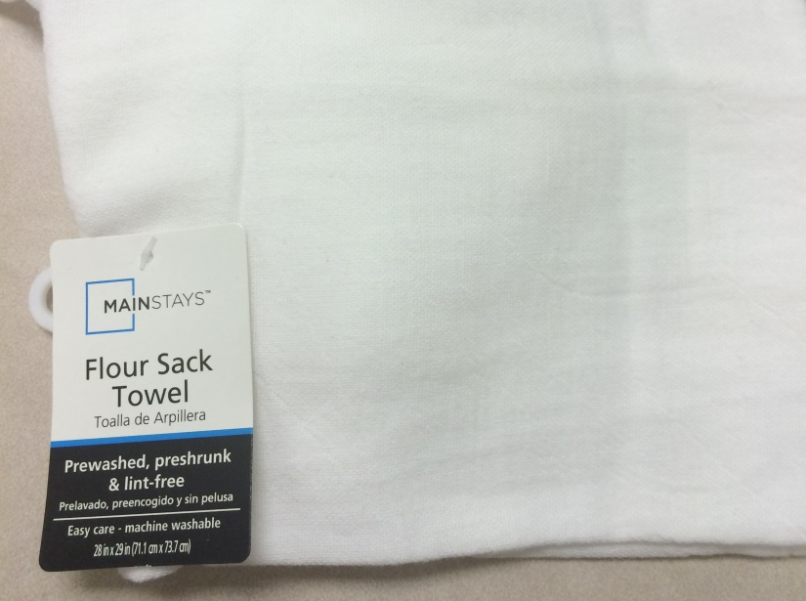
100X image of flour sack towel
1 mm
1 cm
200X image of flour sack towel
1 mm
Flour Sack towel

Slide 17
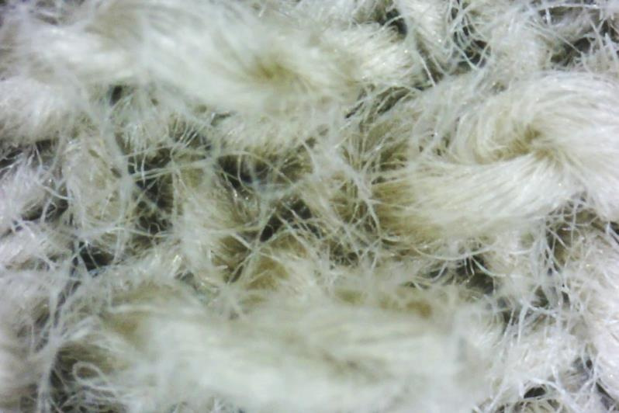
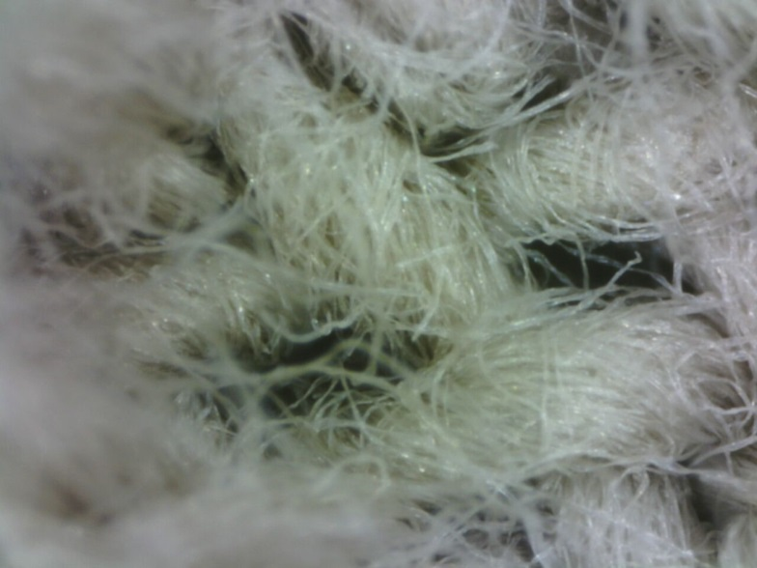
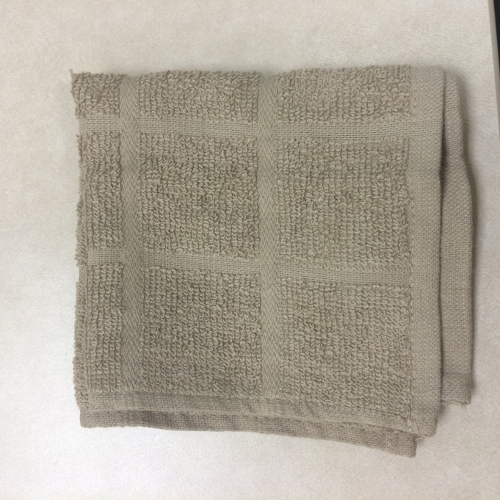
1 mm
1 cm
100X image of a dishcloth
200X image of a dishcloth
1 mm
Dishcloth

Slide 18
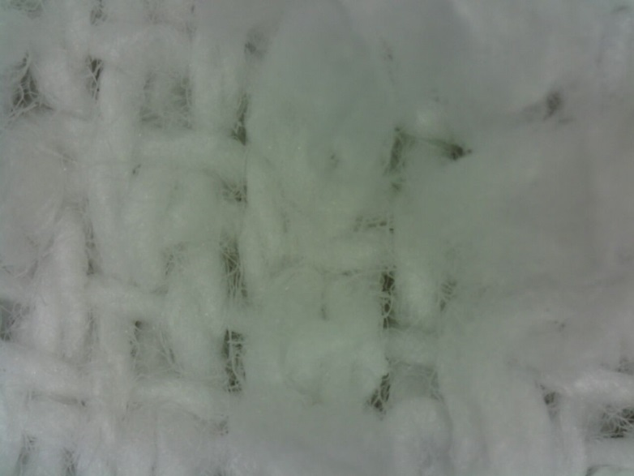
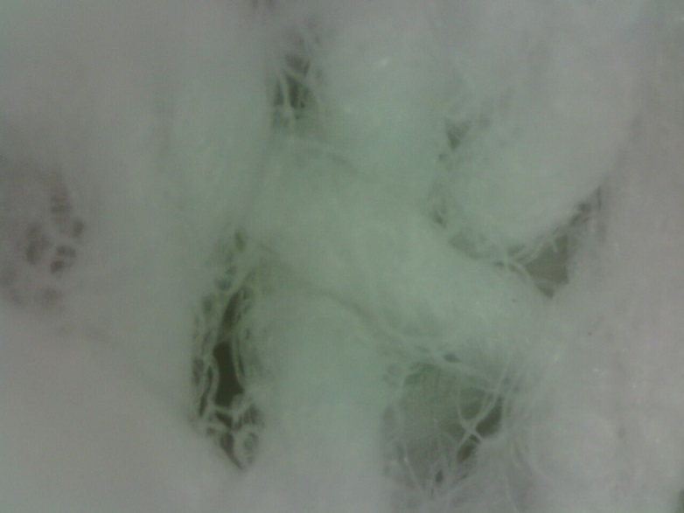
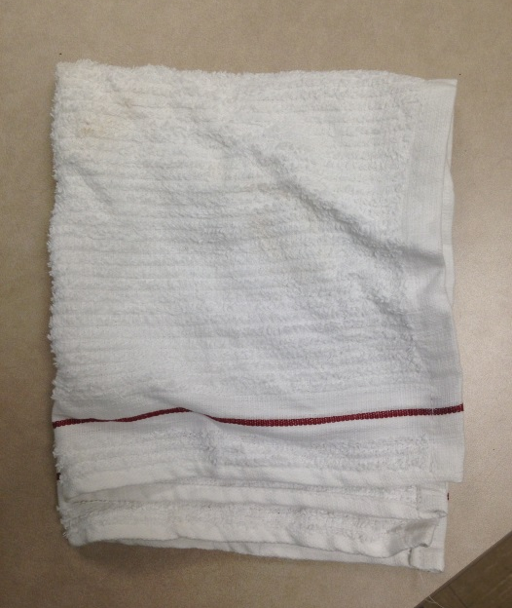
100X image of a kitchen towel
1 mm
1 cm
200X image of a kitchen towel
1 mm
Kitchen towel

Slide 19
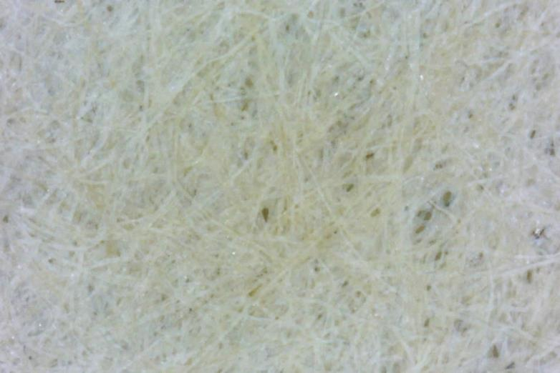
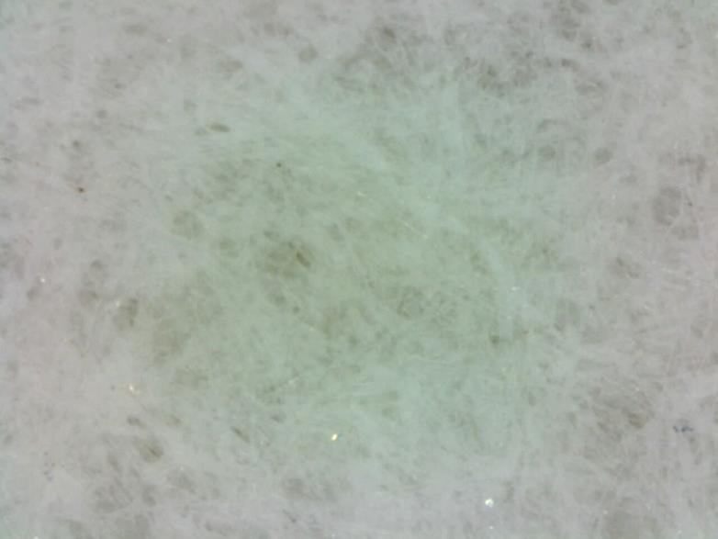
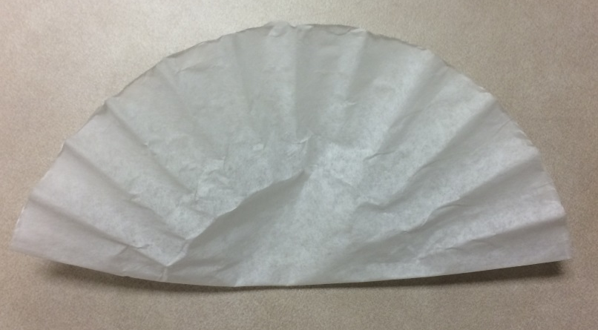
100X image of a white coffee filter
1 mm
1 cm
200X image of a white coffee filter
1 mm
White coffee filter

Slide 20
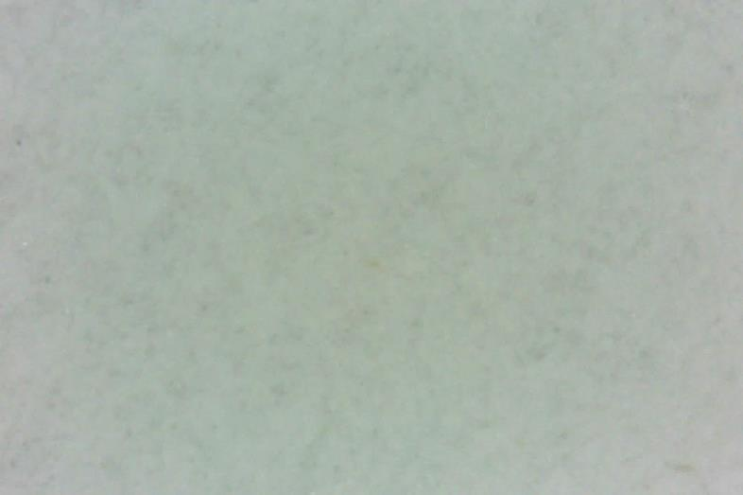

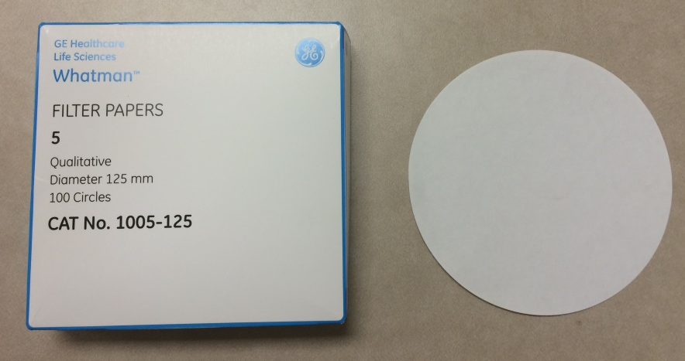
100X image of filter paper
1 mm
1 cm
200X image of filter paper
1 mm
Filter paper

Slide 21
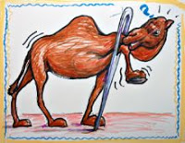
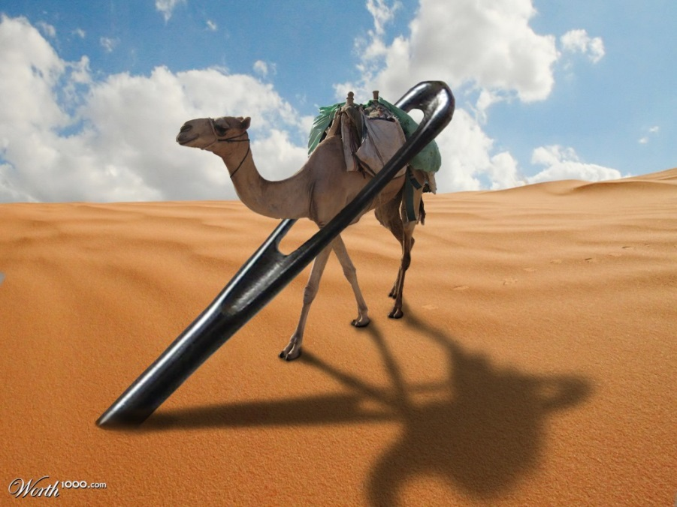
Size Matters!
Why can’t the camel get through the needle?
Notes:
Resources: http://wilfullyobscure.blogspot.com/2011/01/brian-eno-needles-in-camels-eye.html
http://www.worth1000.com/entries/561671/eye-of-a-needle

Slide 22
Camels and Filtration?
Camels = Particles in the water
Needle = Pore size
Can water pass through small holes?
  YES!
Filters allow water to pass through but not particles larger than the pore size
Notes:
Resources: http://encyclopedia.lubopitko-bg.com/movementacrossPM.html

Slide 23
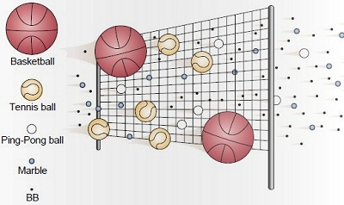
Example
Pore
Size
Large Particles
Small
Particles
BBs, marbles, and ping pong balls can fit through the net BUT tennis balls and basketballs cannot
  Holes in net= pore size
  Basketballs and tennis balls= large particles
  Ping pong balls, marbles, BBs= small particles
Notes:
Resource: http://encyclopedia.lubopitko-bg.com/movementacrossPM.html

Slide 24

Bacteria
How small is bacteria?
  http://learn.genetics.utah.edu/content/cells/scale/
How small of a hole can bacteria fit through?
But bacteria is dangerous!
  So what can we do?
KILL IT!
Notes:
Teacher notes:
Use provided link from this slide for a comparison of how small bacteria is in relation to other objects
Resources: http://www.clipartsheep.com/stop-germs-clipart/

Slide 25
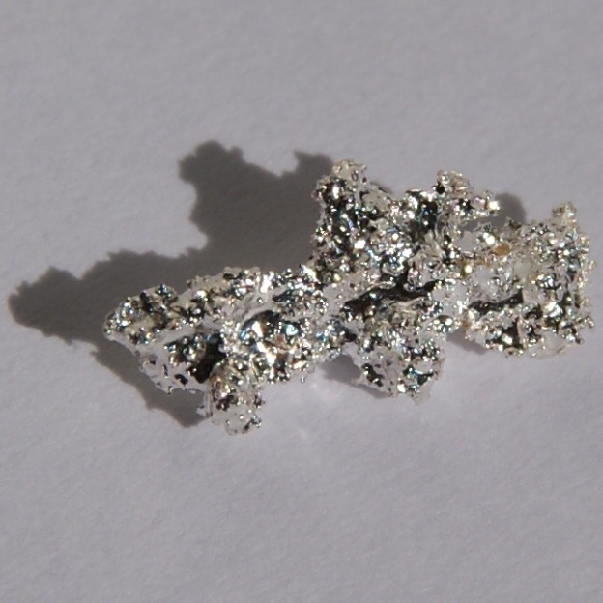
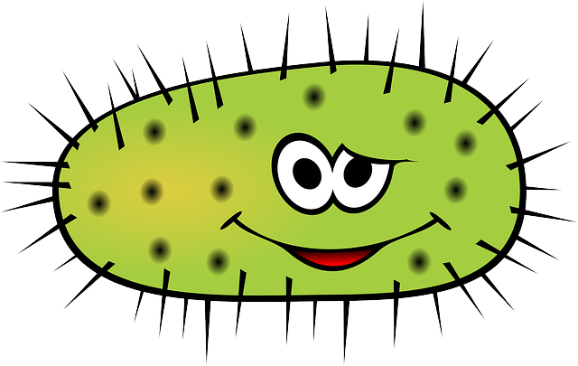

Killing Bacteria
Did you know silver can kill bacteria?!
Notes:
Resources: https://commons.wikimedia.org/wiki/File:Silver-nugget.jpg
https://pixabay.com/en/bacteria-virus-illness-bacterium-156869/https://sgshock.wordpress.com/
https://pixabay.com/en/photos/danger%20of%20death/

Slide 26
Nano-Silver Kills Bacteria
https://www.youtube.com/watch?v=hhOwSQriB8E
Notes:
Resource: https://www.youtube.com/watch?v=hhOwSQriB8E

Slide 27
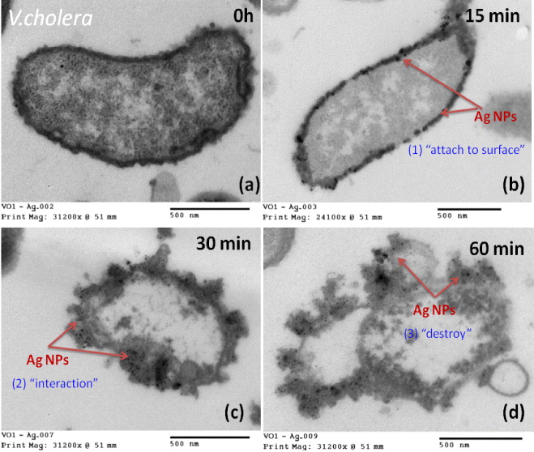
Silver Killing Cholera Bacteria
Notes:
Teacher Notes:
Resource: http://iopscience.iop.org/article/10.1088/2043-6262/3/4/045007;jsessionid=16B55B69285983C83122DDC82C8646A0.c1.iopscience.cld.iop.org
Interesting article on colloidal silver nanoparticles for the prevention of gastrointestinal bacterial infections

Slide 28
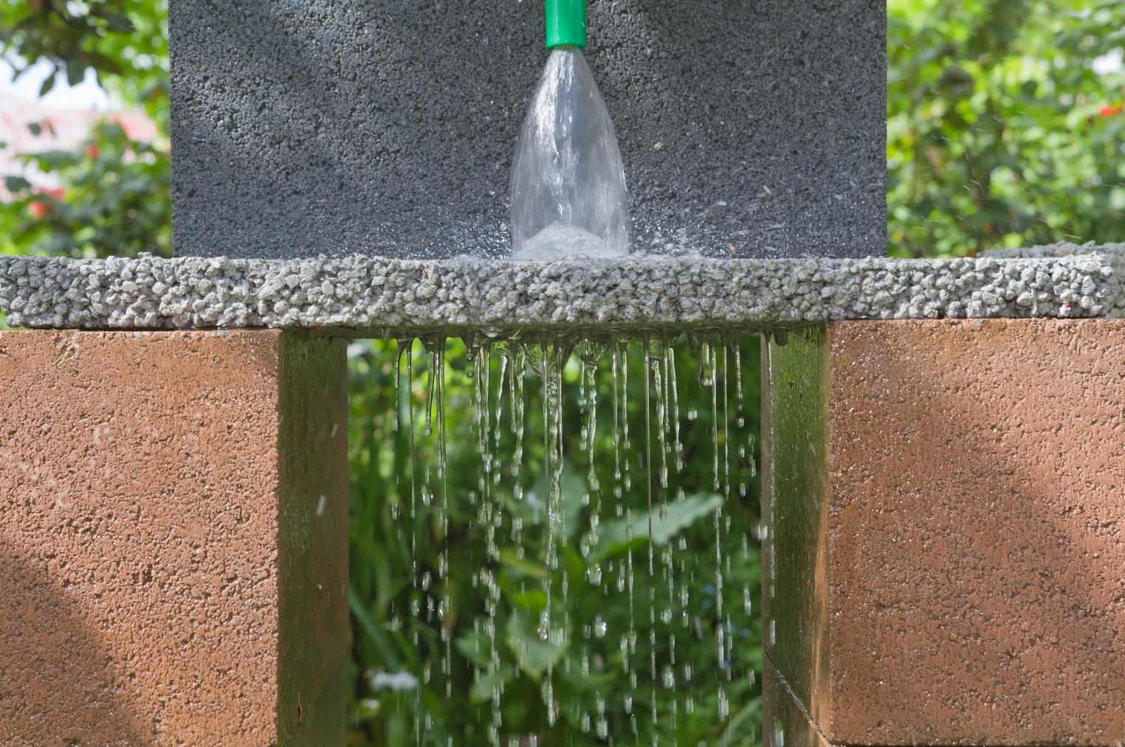
Two ways silver attacks bacterial cells
1st Way: It makes the cell membrane more permeable
  Permeable= allowing liquids or gasses to pass through
Notes:
Resource: https://en.wikipedia.org/wiki/Permeable_paving

Slide 29

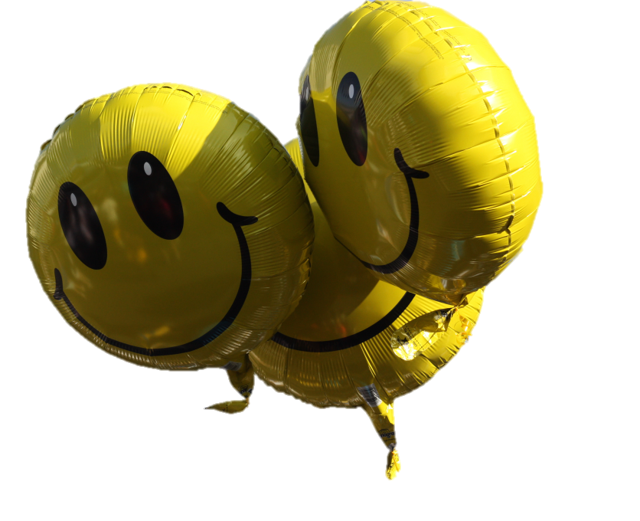
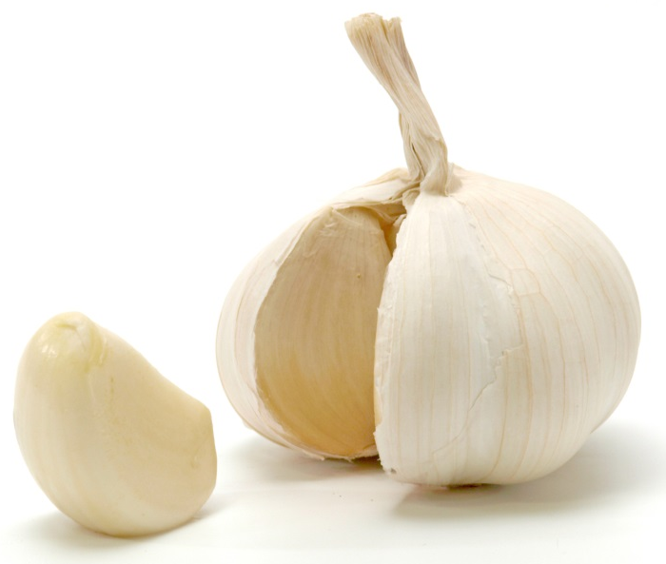
Mylar and latex balloons and garlic
Mylar balloons= before silver
Latex balloons= after silver
Can you smell the garlic??
Notes:
Resources: https://de.wikipedia.org/wiki/Luftballon
https://commons.wikimedia.org/wiki/File:Opened_garlic_bulb_with_garlic_clove.jpg
https://pixabay.com/en/balloon-green-circus-floating-150128/

Slide 30
Two ways silver attacks bacterial cells…
2nd Way: It interferes with the cells METABOLISM, leading to the overproduction of reactive and toxic oxygen compounds
  Metabolism= converting the fuel in the food we eat into the energy needed to power everything we do, from moving to thinking to growing.

Slide 31
1) Silver makes the cell membrane more permeable
Bacterial membrane proteins contain sulfur that helps them fold.
The way it folds gives the bacteria its shape.
The shape of the protein tells it what to do.

Slide 32
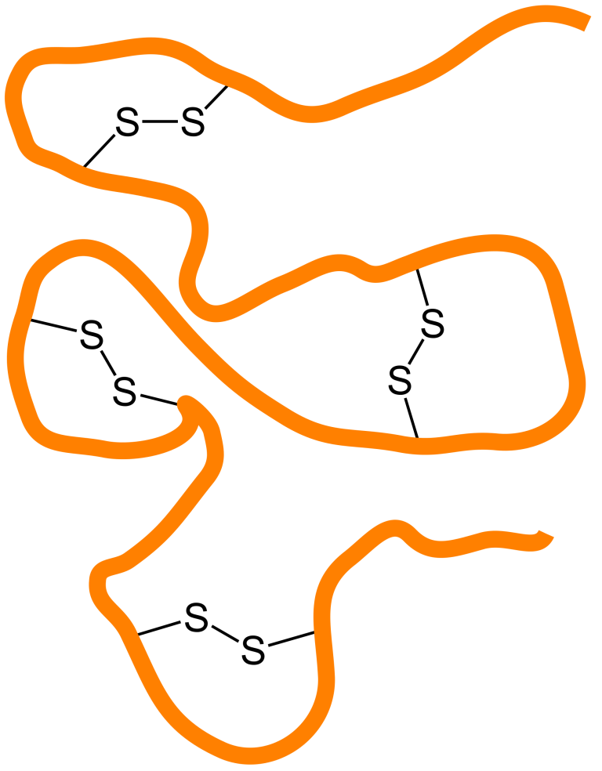
1) Silver makes the cell membrane more permeable
  Silver binds to the sulfur
  When silver binds to sulfur, proteins cannot fold correctly, therefore they cannot do their job!
  When the proteins are not folded correctly, they make the bacteria cell wall weaker.
Ag
Ag
Ag
S
S
S
Ag
Ag
S
S
Ag
Notes:
Resource: http://www.bbc.co.uk/bitesize/ks3/science/chemical_material_behaviour/compounds_mixtures/revision/2/

Slide 33
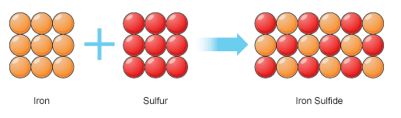
2) Silver interferes with the cells metabolism
    Because silver has interacted with sulfur, iron cannot bind to it
    Because silver has interacted with sulfur, iron cannot bind to it.
    This interferes with the bacteria’s metabolism, which are the chemical processes that occur within a living organism to maintain life.
    Because silver has interacted with sulfur, iron cannot bind to it
Fe-S Clusters
+
+
Ag
Ag
Notes:
Resource: http://www.bbc.co.uk/bitesize/ks3/science/chemical_material_behaviour/compounds_mixtures/revision/2/

Slide 34


After silver stops the bacteria’s metabolism…
Now silver causes bacteria to produce toxic substances
  Toxic substances= Reactive Oxygen Species
    These cause damage to the inside of bacteria cells which harm the DNA, proteins, and the membrane!
Now bacteria cannot defend itself
For example, if a quarterback’s offensive line was tackled, he would get sacked!
Notes:
Resources: https://en.wikipedia.org/wiki/Workplace_Hazardous_Materials_Information_System
https://www.flickr.com/photos/keithallison/15566643088

Slide 35
Possible Review Questions
How is water filtered?
How does pore size relate to water filtration?
What role does silver play in water filtration?
Notes:
Teacher Notes:
Transition: Now that we have learned how water filtration works, we will actually be filtering water.

Slide 36
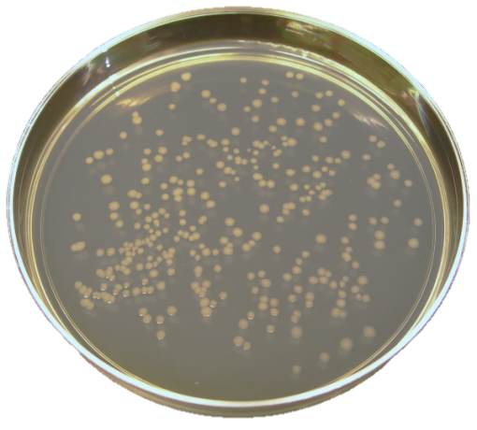
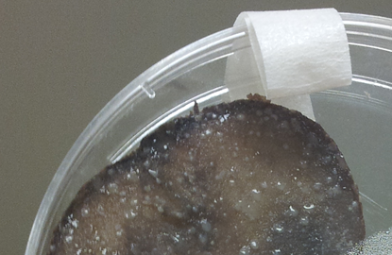
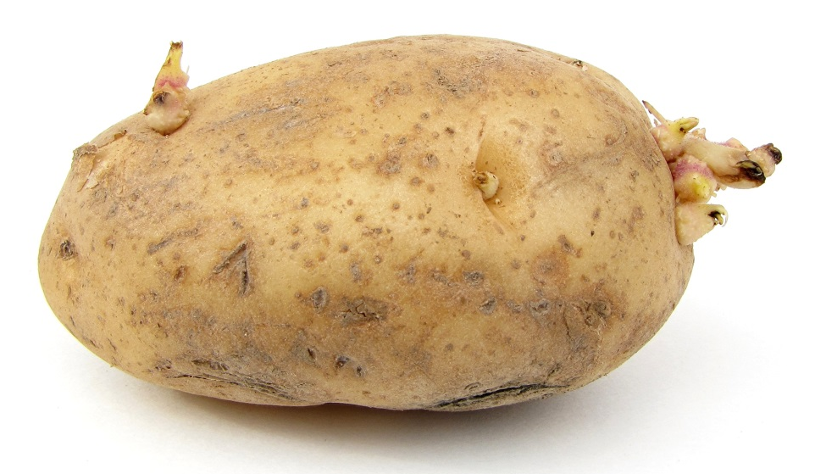
Potatoes and Bacteria??
Scientists often use culture plates to grow bacteria because the plates are made with nutrients that bacteria can use.
We can also find those nutrients in potatoes!
  So we can use potatoes to grow bacteria instead of using culture plates!
Colonies!
Notes:
Resource: https://en.wikipedia.org/wiki/Potato
Resource: https://upload.wikimedia.org/wikipedia/commons/7/73/Ecoli_colonies.png

Slide 37
Water Filtration and Bacterial Growth on Potatoes

Slide 38
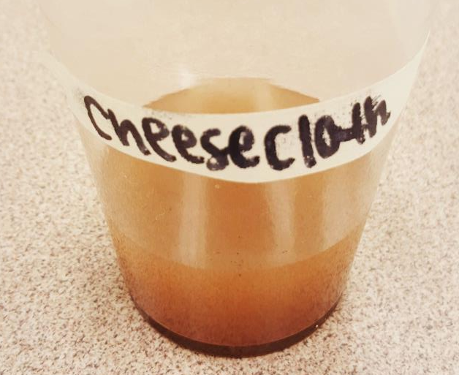
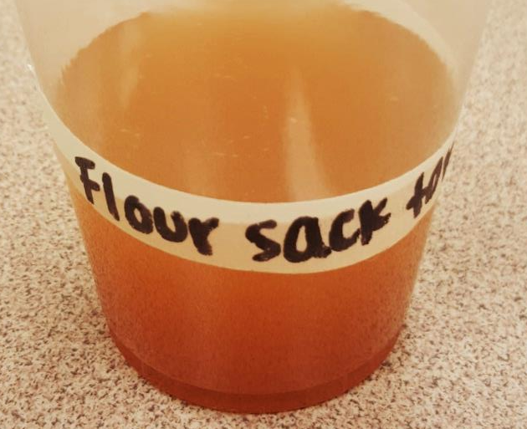




Expected Outcomes After Filtration….
Cheesecloth Filter
Flour Sack Filter
Kitchen Towel Filter
Dishcloth Filter
Coffee Filter
Filter paper

Slide 39
What do we see?
What kind of differences do we see in each of these filters?
Do some cloths seem to filter more of the dirt out?
Has any of the color changed?
What do you think we would need to do to see a more dramatic change?

Slide 40

Notes:
Teacher Note:
We found that boiling the potatoes at 2 minutes is sufficient for sanitizing

Slide 41
Resources
Information about drinking water: http://www.cdc.gov/healthywater/drinking/public/water_treatment.html
Information on China and their drinking water: http://www.naturalnews.com/045089_industrial_pollution_China_drinking_water.html# ; http://www.chinatravel.com/facts/drinking-water.htm
Video about the drinkable book: https://drinkablebook.tilt.com/the-drinkable-book
Interactive nanoscale graphic: http://learn.genetics.utah.edu/content/cells/scale/
Nano silver killing bacteria video: https://www.youtube.com/watch?v=hhOwSQriB8E

Slide 42
Additional Helpful Links
Silver Antimicrobial Ions & Bacteria video: https://youtu.be/NYDOZzpH99E
How Silver Kills Bacteria Webpage: http://www.bullionstreet.com/news/how-silver-kills-bacteria-finally-revealed/5042
NiseNet Water Filtration Lesson Plan: http://www.nisenet.org/catalog/programs/cleaning_our_water_nanotechnology
Flocculation: Making clean water: https://www.khanacademy.org/partner-content/mit-k12/mit-k12-materials/v/flocculation
The water cycle: http://climate.ncsu.edu/edu/k12/.watercycle
Nanotechnology for clean water: Facts and Figures: http://www.scidev.net/global/water/feature/nanotechnology-for-clean-water-facts-and-figures.html
Water Filtration and Purity of Water (Middle and High School curriculum lesson): http://nisenet.org/catalog/water-filtration-and-purity-water-middle-and-high-school-curriculum-lesson
Eliminating water-borne bacteria with pages from The Drinkable Book could save lives: https://www.youtube.com/watch?v=BeS9y6Qffc4
Microwave-assisted incorporation of silver nanoparticles in paper for point-of-use water purification (Theresa A. Dankovich)

Slide 43
Photo Citations
Cover photo of water fall: https://unsplash.com/photos/kDj82KFbRvU/download
Photo of dirty and clean water: http://diyprepping.com/tag/clean-water/
Photo of tap water: http://www.distilledwaterassociation.org/bottled-water-vs-tap-water-drink-it-with-or-without-poop/
Photo of bacteria in dirty water: http://dirtywaterintheworld.weebly.com/illness-and-disease.html
Water fountain photo: http://coloradobip.sgm-inc.com/
Fishing in a dirty river picture: http://en.mercopress.com/2009/12/04/china-attacks-water-pollution-and-plans-massive-investments
Chart about contaminated water in China: http://www.100smarterlivingideas.com/drinkable-book/
China smog picture: http://news.asiaone.com/news/business/chinas-smog-driving-top-foreign-talent-away-us-business-survey ; http://www.cnn.com/2014/01/06/opinion/china-pollution-opinion-taoxie/index.html
Chart about U.S. and China relations: http://www.americanmanufacturing.org/blog/entry/the-u.s.-imports-a-lot-of-food-from-china-and-you-might-be-surprised-whats
The drinkable book picture: http://waterislife.com/clean-water/new-technology
Picture of President Obama drinking water: http://www.zimbio.com/pictures/tR_OFqNkpP7/Gordon+Brown+President+Obama+Hold+Talks+Foreign/1ZKzlHBd7Jc/Barack+Obama
Nanotechnology chalkboard photo: http://www.nanotechproject.org/topics/nano101/
Fingernail photo: https://commons.wikimedia.org/wiki/File:Ongle_du_doigt_de_la_main_-_Fingernail_hand.jpg
Earth photo: http://www.solstation.com/stars/earth.htm
Tennis ball picture: http://www.clipartbest.com/tennis-ball-picture
Magnifying glass photo: http://www.clipartpanda.com/categories/magnifying-glass-clipart-transparent-background

Slide 44
Photo Citations
Camel in needle pictures: http://wilfullyobscure.blogspot.com/2011/01/brian-eno-needles-in-camels-eye.html ; http://www.worth1000.com/entries/561671/eye-of-a-needle
Filtration with different sporting balls: http://encyclopedia.lubopitko-bg.com/movementacrossPM.html
Killing bacteria clipart: http://www.clipartsheep.com/stop-germs-clipart/
Silver picture: https://commons.wikimedia.org/wiki/File:Silver-nugget.jpg
Bacteria clipart: https://pixabay.com/en/bacteria-virus-illness-bacterium-156869/https://sgshock.wordpress.com/
Skeleton clipart: https://pixabay.com/en/photos/danger%20of%20death/
Mylar balloon picture: https://de.wikipedia.org/wiki/Luftballon
Garlic picture: https://commons.wikimedia.org/wiki/File:Opened_garlic_bulb_with_garlic_clove.jpg
Latex balloon picture: https://pixabay.com/en/balloon-green-circus-floating-150128/
Permeability picture: https://en.wikipedia.org/wiki/Permeable_paving
Iron and Sulfur image: http://www.bbc.co.uk/bitesize/ks3/science/chemical_material_behaviour/compounds_mixtures/revision/2/
Toxic clipart: https://en.wikipedia.org/wiki/Workplace_Hazardous_Materials_Information_System
Quarterback being sacked picture: https://www.flickr.com/photos/keithallison/15566643088
TSA plate photo: https://upload.wikimedia.org/wikipedia/commons/7/73/Ecoli_colonies.png
Potato clipart picture: https://en.wikipedia.org/wiki/Potato

